Slide 1
Hour 8
Repeating an Action with Loops

Slide 2
Review
Last time we learned about conditionals and how they work
“if” statement
“else” statement
“else if” statement
“switch statements

Slide 3
Review
Keywords
case
class
default
else
extends
final
if
import
public
static
switch
void
Special characters
( )
{ }
[ ]
Operators
= - assignment
+ - add/concatenate
- - subtract
* - multiply
/ - divide
% - modulus
++ - increment
-- - decrement
+= - increment assign
? : - conditional/tenary
Types
boolean
byte
char
double
float
Graphics
int
long
short
String
API Calls
Double.parseDouble()
Graphics.drawString()
Integer.parseInt()
Math.sqrt()
String.equals()
String.indexOf()
String.length()
String.toLowerCase()
String.toUpperCase()
System.out.print()
System.out.println()

Slide 4

“for” Loops
“for” loops repeat a block of code a fixed number of times
The variable “index” is used to count the number of times through the loop
starts the index at 0 the first time through
stops the loop before the index reaches 10
adds one to the index each time through the loop

Slide 5

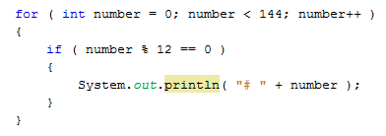
“for” Loops
“for” loops can consist of ONE line without curly braces
Loops can contain “if” statements
In this example, the contents of the if block is executed depending on the value of number, which changes every time through the loop

Slide 6
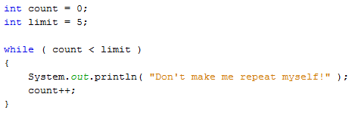
“while” Loops
"while" loops repeat while the condition is true
This loop will stop when count equals 5
If count is not incremented the loop will repeat FOREVER!

Slide 7
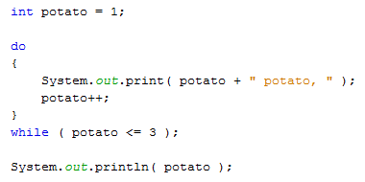
“do-while” Loops
"do-while" loops are similar to "while" loops, but the condition is checked at the end
This guarantees that the contents of the loop will be executed at least once

Slide 8
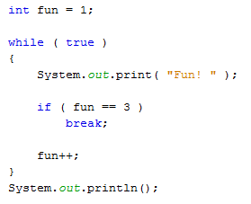
Exiting a Loop
A break statement can be used to exit a loop
This loop will continue until fun is equal to 3, then it will exit immediately

Slide 9
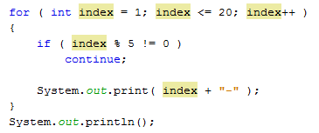
Exiting a Loop
A continue statement can be used to skip part of the code in a loop
This loop will only print when index is divisible by 5

Slide 10
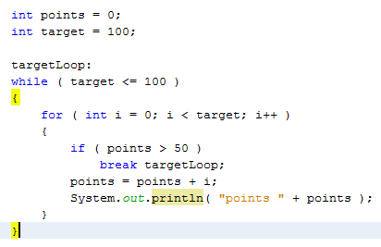
Naming a Loop
Sometimes you need to have a loop inside a loop
You may want to exit both loops as once
You need to use a label for the loop
Loop Label

Slide 11
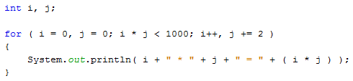
Complex “for” Loops
"for" loops can have more that one index value
There are 2 indexes, i and j
Both are initialized to 0
Both are used in the conditional
Both are incremented each time through the loop

Slide 12
Summary

Slide 13
Questions

Slide 14
Homework
Read the pages 102-104 (Test Your Computer Speed)
Copy the program and run it
Make sure you understand how the loop works
Change your SecretWord program so that:
Instead of using args[0], it uses the following to read the guess from the user:
Scanner readUserInput = new Scanner(System.in);
-- and --
System.out.print( "Enter your guess: " );
String guess = readUserInput.nextLine();
Loop until the user guesses the right answer

